Slide 1
Cardiovascular system

Slide 2
Random cardiovascular facts
there are about 100,000 km of blood vessels in the body that would go around the world 2.5 times
the heart creates enough pressure in the left ventricle to squirt blood 9.1 meters
capillaries are about 1/30th the diameter of a human hair
it takes 1 minute for a blood cell to circulate around the entire body
human heart rate = 100,800 beats/day

Slide 3
BIG PICTURE: Heart Anatomy
The Pulmonary and Systemic Circuits
Heart is a transport system consisting of two side-by-side pumps
Right side receives oxygen-poor blood from tissues
Pumps blood to lungs to get rid of CO₂, pick up O₂, via pulmonary circuit
Left side receives oxygenated blood from lungs
Pumps blood to body tissues via systemic circuit

Slide 4
The Pulmonary and Systemic Circuits (cont.)
Receiving chambers of heart
Right atrium
Receives blood returning from systemic circuit
Left atrium
Receives blood returning from pulmonary circuit
Pumping chambers of heart
Right ventricle
Pumps blood through pulmonary circuit
Left ventricle
Pumps blood through systemic circuit

Slide 5
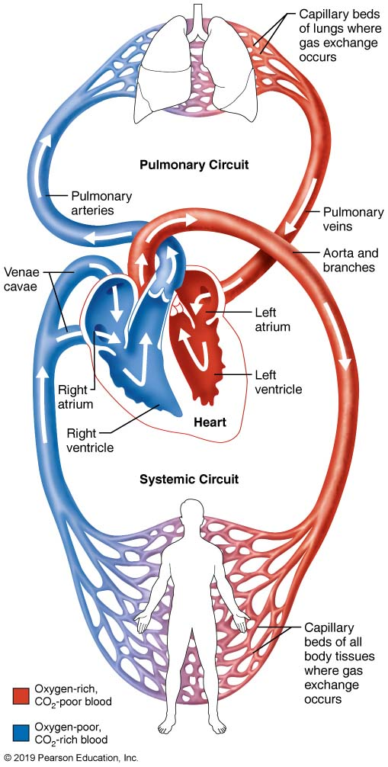
The systemic and pulmonary circuits.

Slide 6
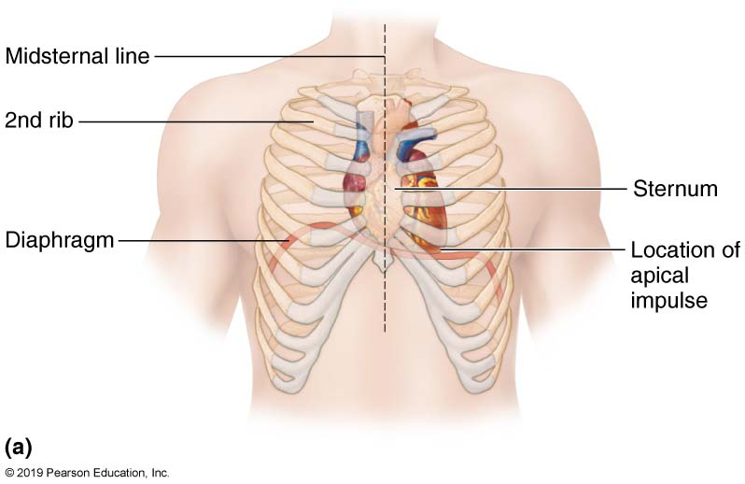
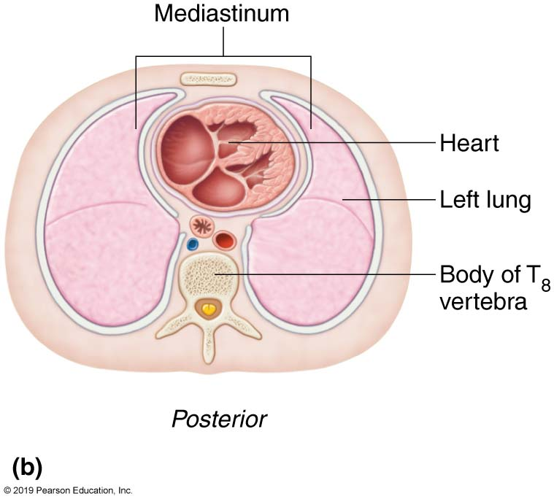
Heart Anatomy

Slide 7
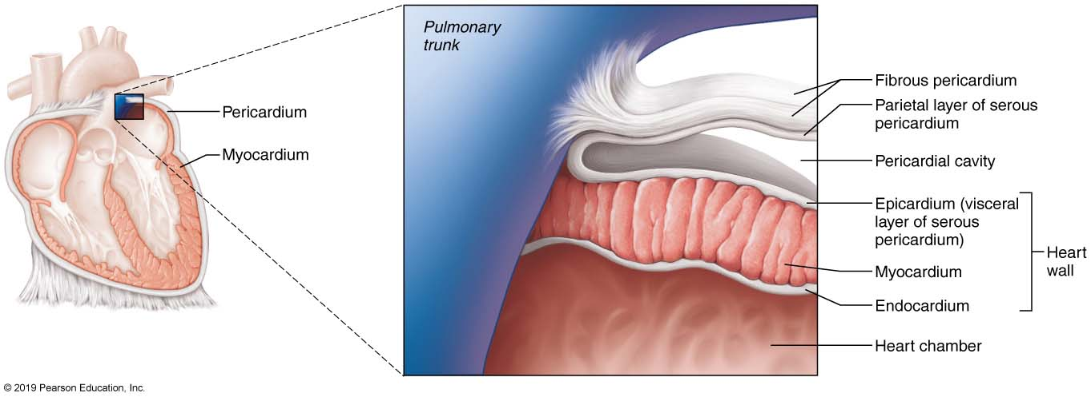
Pericardial Layers of the Heart
Figure 18.2

Slide 8
Clinical – Homeostatic Imbalance 18.1
Pericarditis
Inflammation of pericardium
Roughens membrane surfaces, causing pericardial friction rub (creaking sound) heard with stethoscope
Cardiac tamponade
Excess fluid that leaks into pericardial space
Can compress heart’s pumping ability
Treatment: fluid is drawn out of cavity (usually with syringe)

Slide 9
Heart Wall
Epicardium – visceral layer of the serous pericardium
Myocardium – cardiac muscle layer forming the bulk of the heart
Fibrous skeleton of the heart – crisscrossing, interlacing layer of connective tissue
Endocardium – endothelial layer of the inner myocardial surface

Slide 10
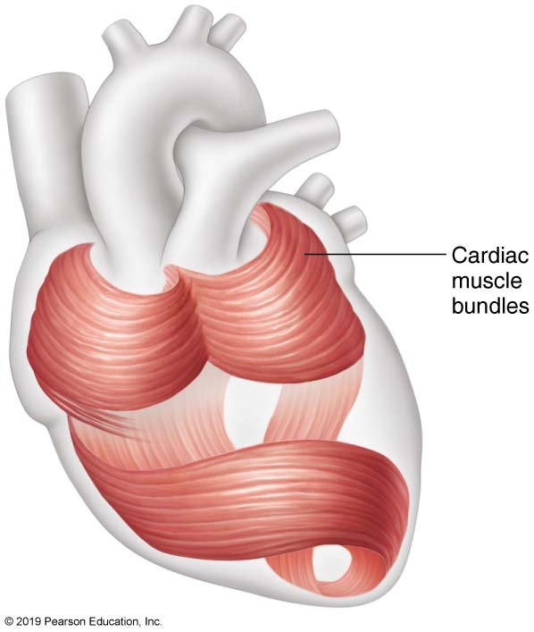
Cardiac Muscle Bundles

Slide 11
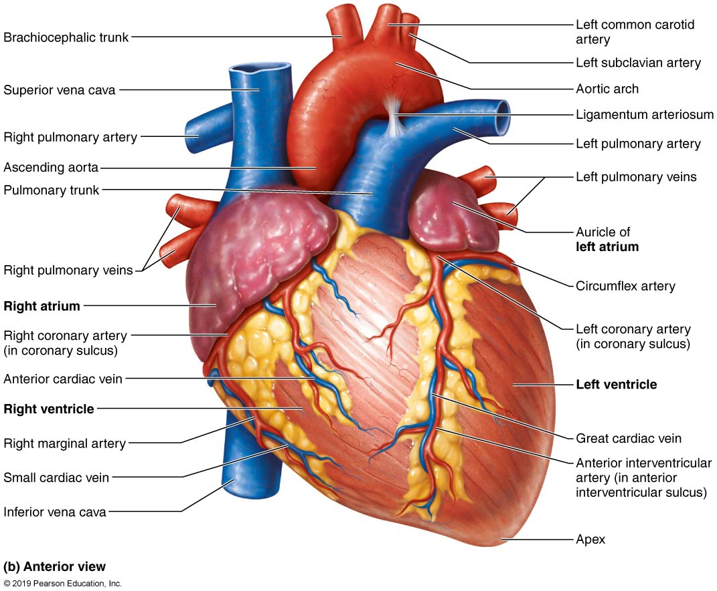
Gross Anatomy of the Heart pt 1

Slide 12
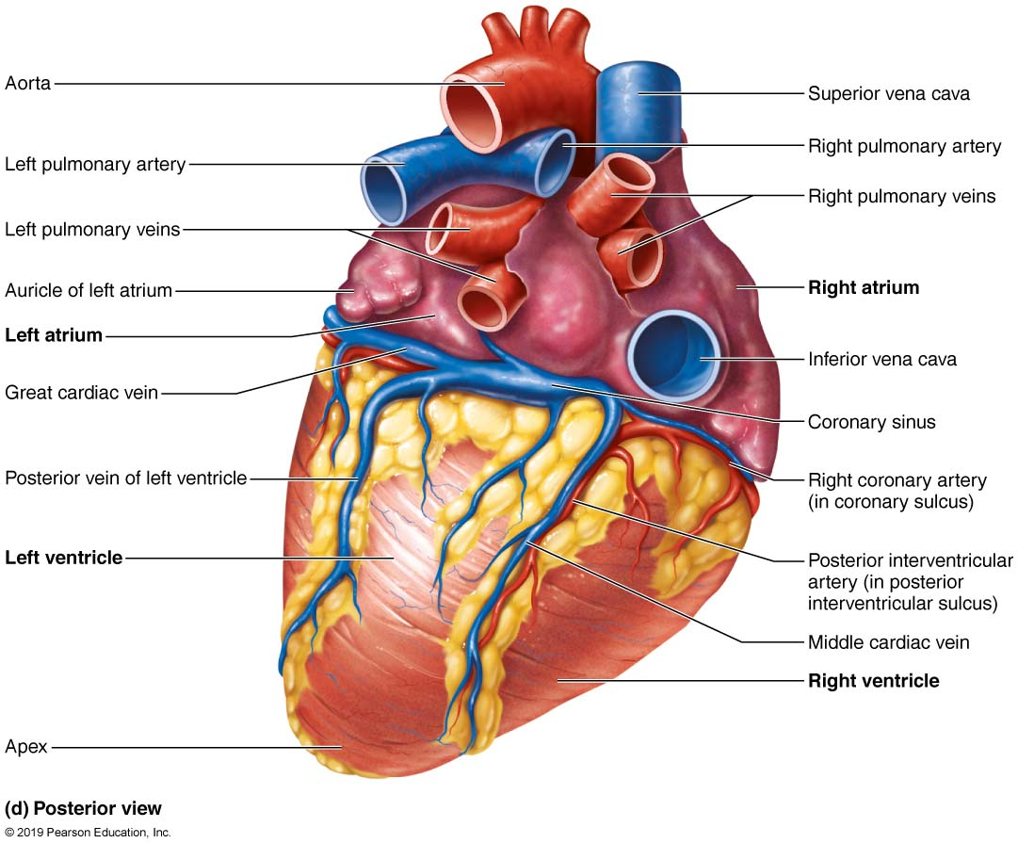
Gross Anatomy of the Heart pt 2

Slide 13
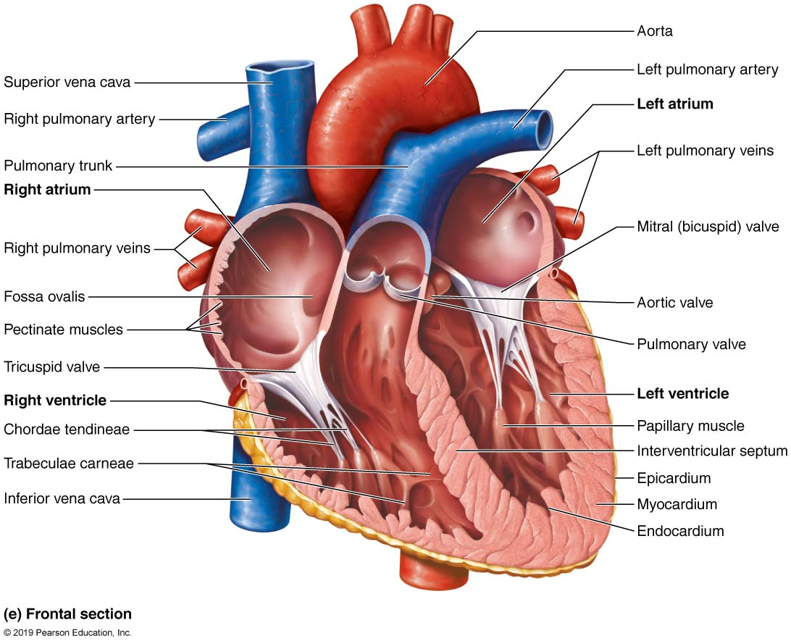
Gross Anatomy of the Heart pt 3

Slide 14
Atria of the Heart
Atria are the receiving chambers of the heart
Each atrium has a protruding auricle
Pectinate muscles mark atrial walls
Blood enters right atria from superior and inferior venae cavae and coronary sinus
Blood enters left atria from pulmonary veins

Slide 15
Ventricles of the Heart
Ventricles are the discharging chambers of the heart
Papillary muscles and trabeculae carneae muscles mark ventricular walls
Right ventricle pumps blood into the pulmonary trunk
Left ventricle pumps blood into the aorta

Slide 16
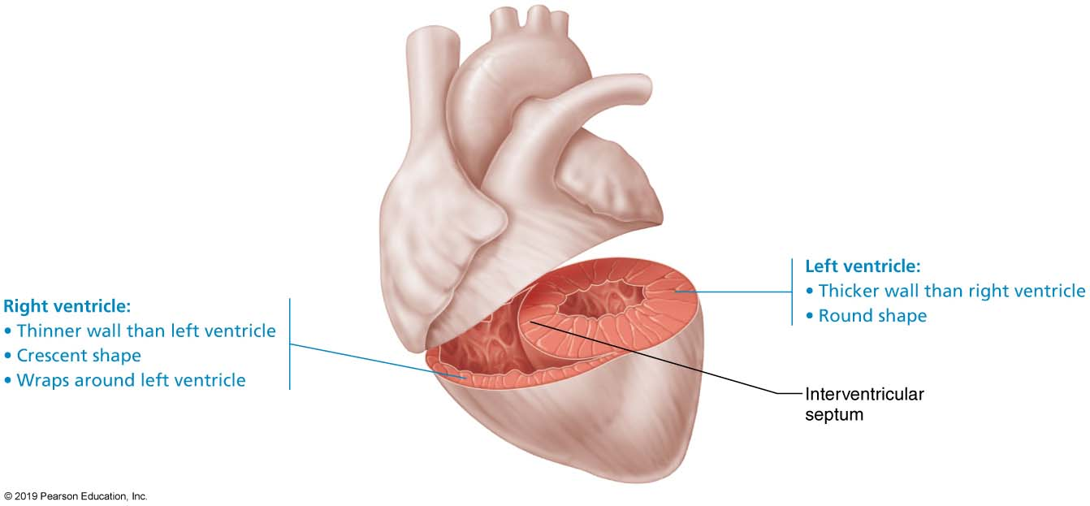
Right and Left Ventricles

Slide 17
Pathway of Blood Through the Heart and Lungs (graphic)

Slide 18
Pathway of Blood Through the Heart and Lungs
Right atrium → tricuspid valve → right ventricle
Right ventricle → pulmonary semilunar valve → pulmonary arteries → lungs
Lungs → pulmonary veins → left atrium
Left atrium → bicuspid valve → left ventricle
Left ventricle → aortic semilunar valve → aorta
Aorta → systemic circulation

Slide 19
Coronary Circulation
Coronary circulation is the functional blood supply to the heart muscle itself
Collateral routes ensure blood delivery to heart even if major vessels are occluded

Slide 20
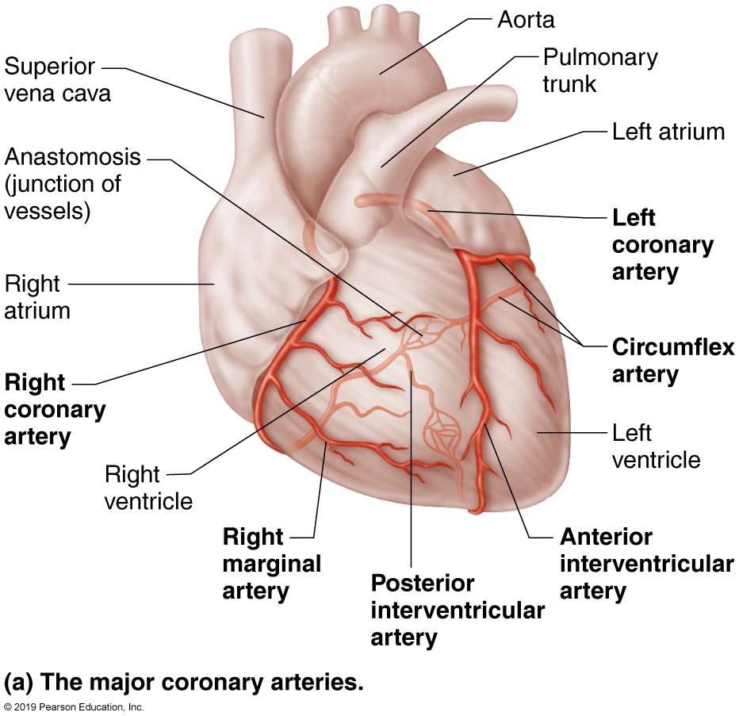
Coronary Circulation: Arterial Supply

Slide 21
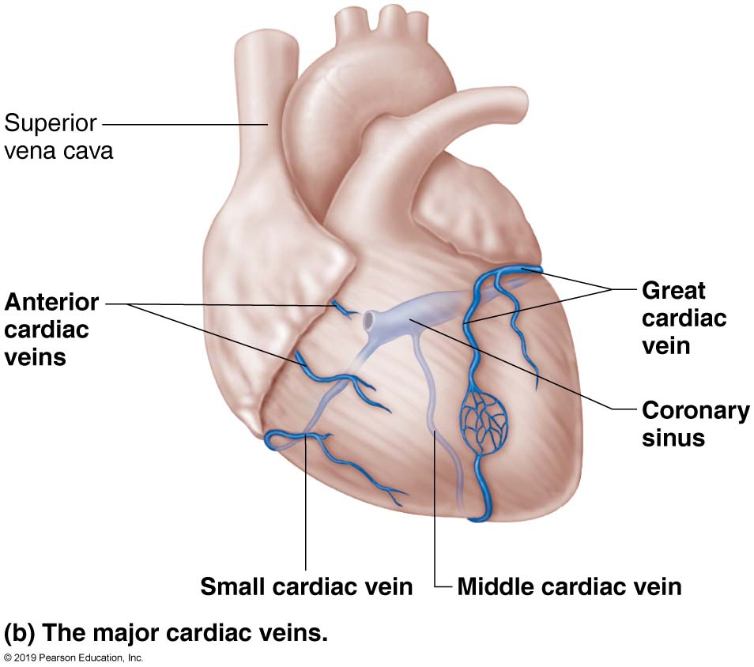
Coronary Circulation: Venous Supply

Slide 22
Heart Valves
Heart valves ensure unidirectional blood flow through the heart
Atrioventricular (AV) valves lie between the atria and the ventricles
AV valves prevent backflow into the atria when ventricles contract
Chordae tendineae anchor AV valves to papillary muscles

Slide 23
Heart Valves pt 2
Aortic semilunar valve lies between the left ventricle and the aorta
Pulmonary semilunar valve lies between the right ventricle and pulmonary trunk
Semilunar valves prevent backflow of blood into the ventricles

Slide 24
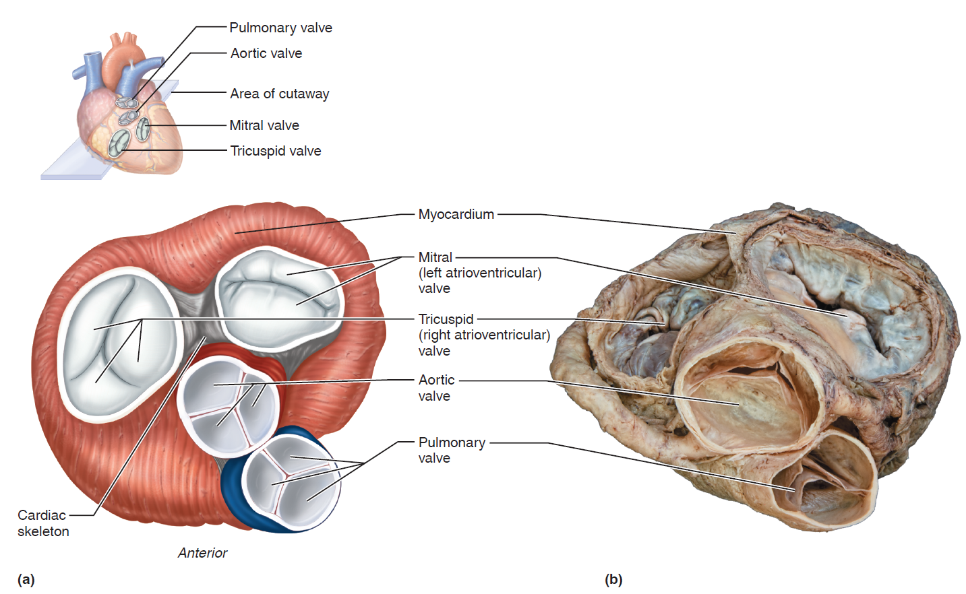
Heart Valves (image 1)

Slide 25
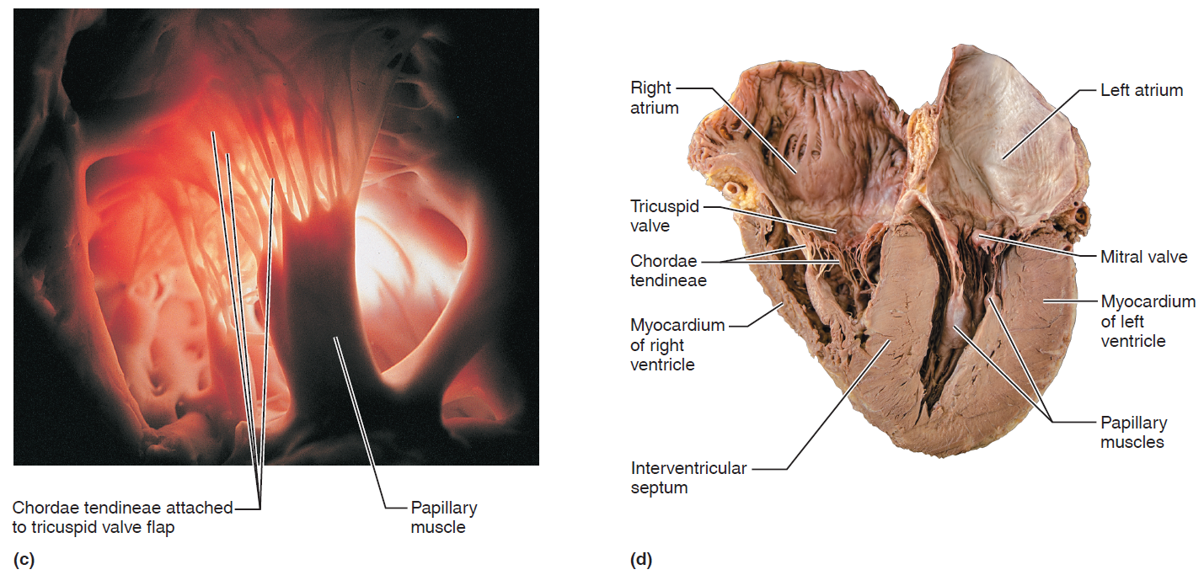
Heart Valves (image 2)

Slide 26
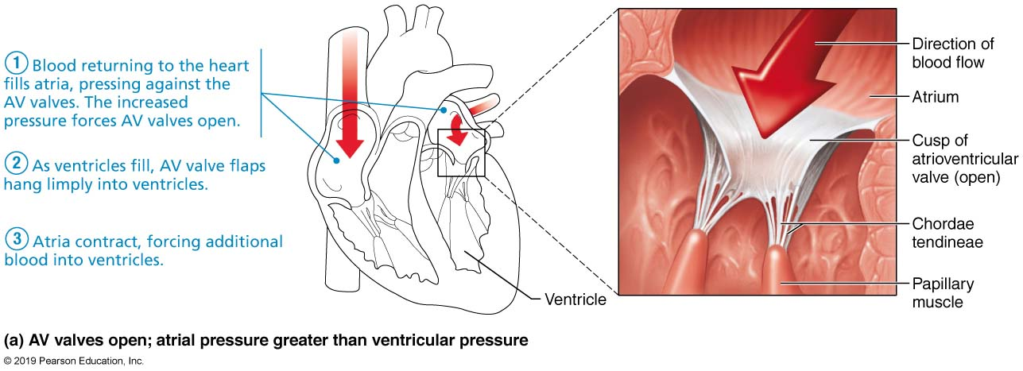
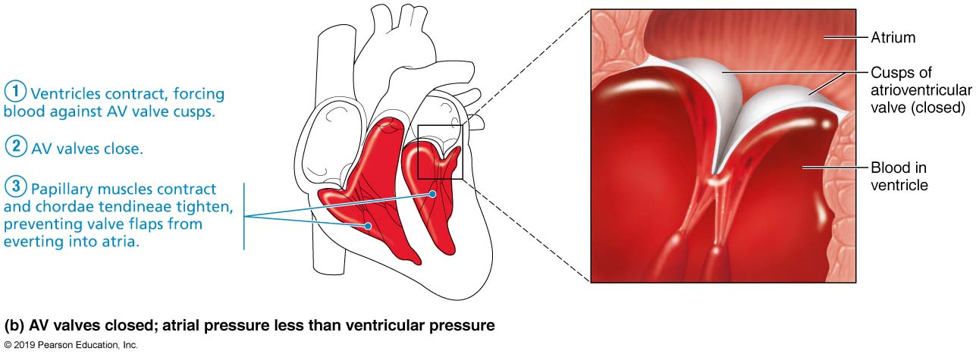
Atrioventricular Valve Function

Slide 27
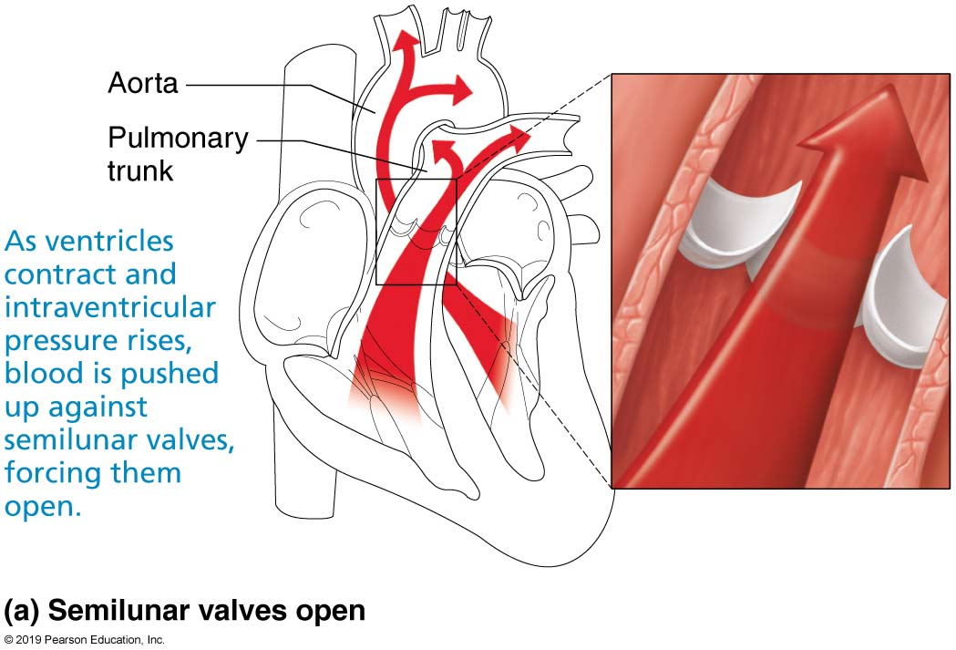
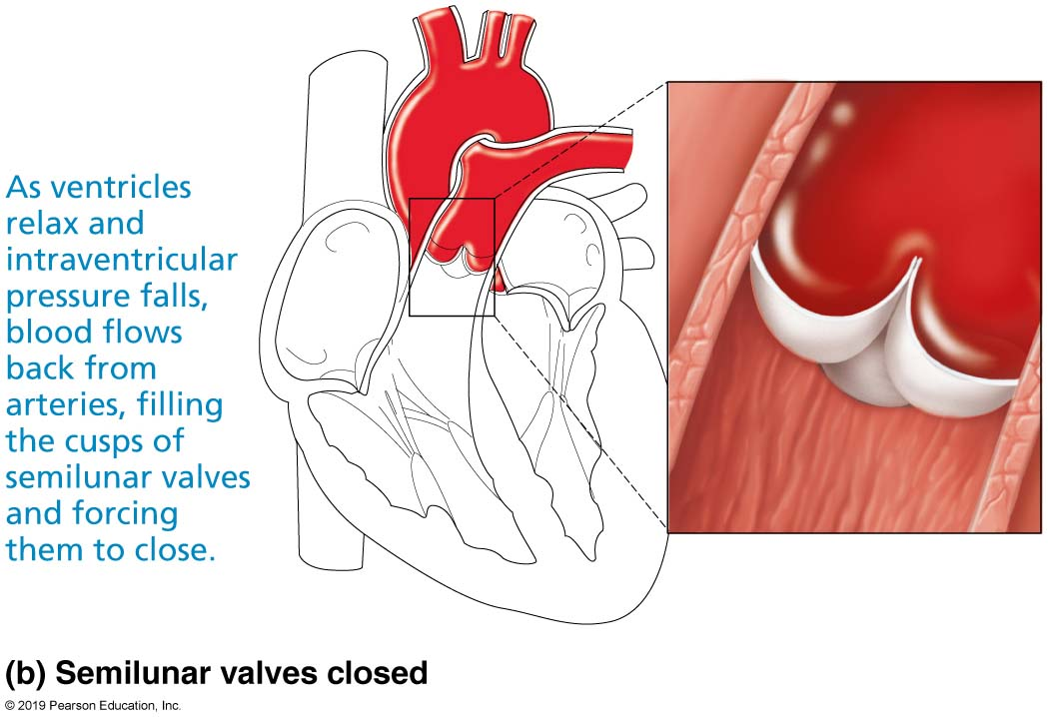
Semilunar Valve Function

Slide 28
Clinical – Homeostatic Imbalance 18.2
Two conditions severely weaken heart:
Incompetent valve
Blood backflows so heart repumps same blood over and over
Valvular stenosis
Stiff flaps that constrict opening
Heart needs to exert more force to pump blood
Defective valve can be replaced with mechanical, animal, or cadaver valve

Slide 29
18.3 Pathway of Blood Through Heart
Equal volumes of blood are pumped to pulmonary and systemic circuits
Pulmonary circuit is short, low-pressure circulation
Systemic circuit is long, high-friction circulation
Anatomy of ventricles reflects differences
Left ventricle walls are 3× thicker than right
Pumps with greater pressure

Slide 30
Clinical – Homeostatic Imbalance 18.3
Angina pectoris
Thoracic pain caused by fleeting deficiency in blood delivery to myocardium
Cells are weakened
Myocardial infarction (heart attack)
Prolonged coronary blockage
Areas of cell death are repaired with noncontractile scar tissue

Slide 31
BIG TOPIC: MicroscopicHeart Muscle
Cardiac muscle is striated, short, fat, branched, and interconnected
The connective tissue endomysium acts as both tendon and insertion
Intercalated discs anchor cardiac cells together and allow free passage of ions
Heart muscle behaves as a functional syncytium
PLAY
InterActive Physiology ®:
Anatomy Review: The Heart, pages 3–7

Slide 32
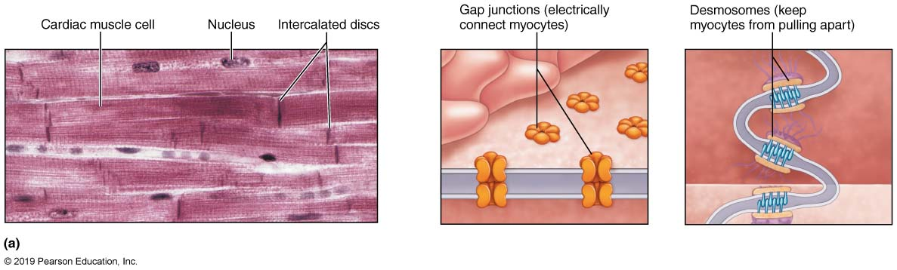
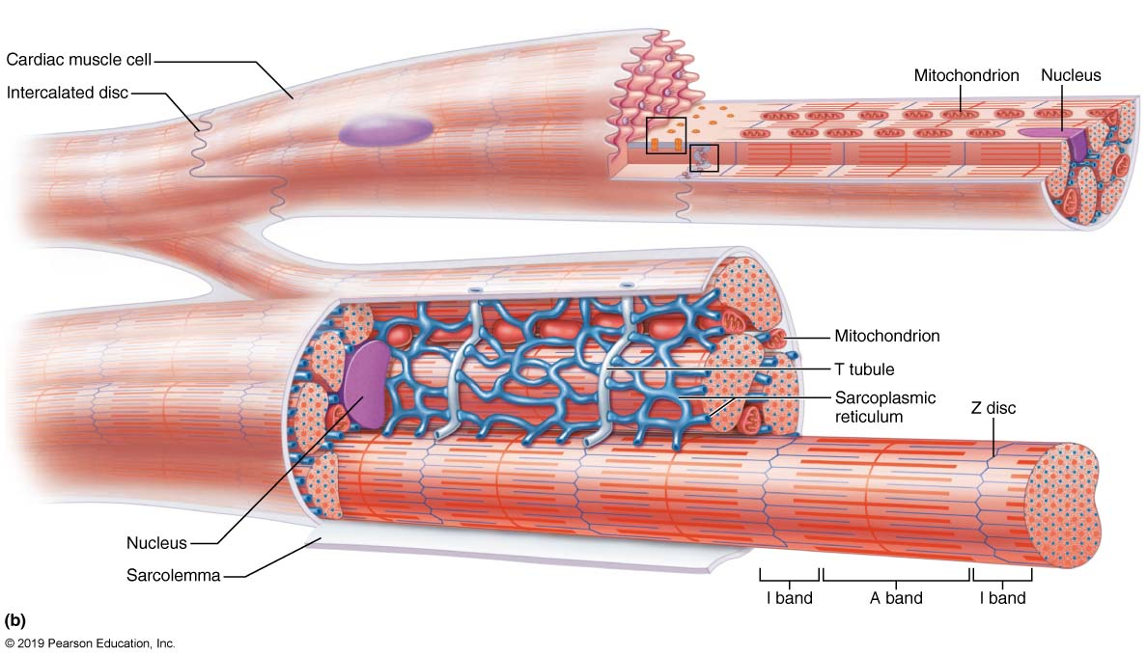
Microscopic Anatomy of Cardiac Muscle

Slide 33
18.4 Cardiac Muscle Fibers
Cardiac muscle cells: striated, short, branched, fat, interconnected
One central nucleus (at most, 2 nuclei)
Contain numerous large mitochondria (25–35% of cell volume) that afford resistance to fatigue
Rest of volume composed of sarcomeres
Z discs, A bands, and I bands all present
T tubules are wider, but less numerous
Enter cell only once at Z disc
SR simpler than in skeletal muscle; no triads

Slide 34
Cardiac Muscle Contraction
Heart muscle:
Is stimulated by nerves and is self-excitable (automaticity)
Contracts as a unit
Has a long (250 ms) absolute refractory period
Cardiac muscle contraction is similar to skeletal muscle contraction
2 types of muscle
Contractile cells (99%)
Autorhythmic cells (<1%)

Slide 35
Heart Physiology: Intrinsic Conduction System
Autorhythmic cells (<1% of all cardiac muscle cells):
Initiate action potentials
Have unstable resting potentials called pacemaker potentials
Use calcium influx (rather than sodium) for rising phase of the action potential

Slide 36
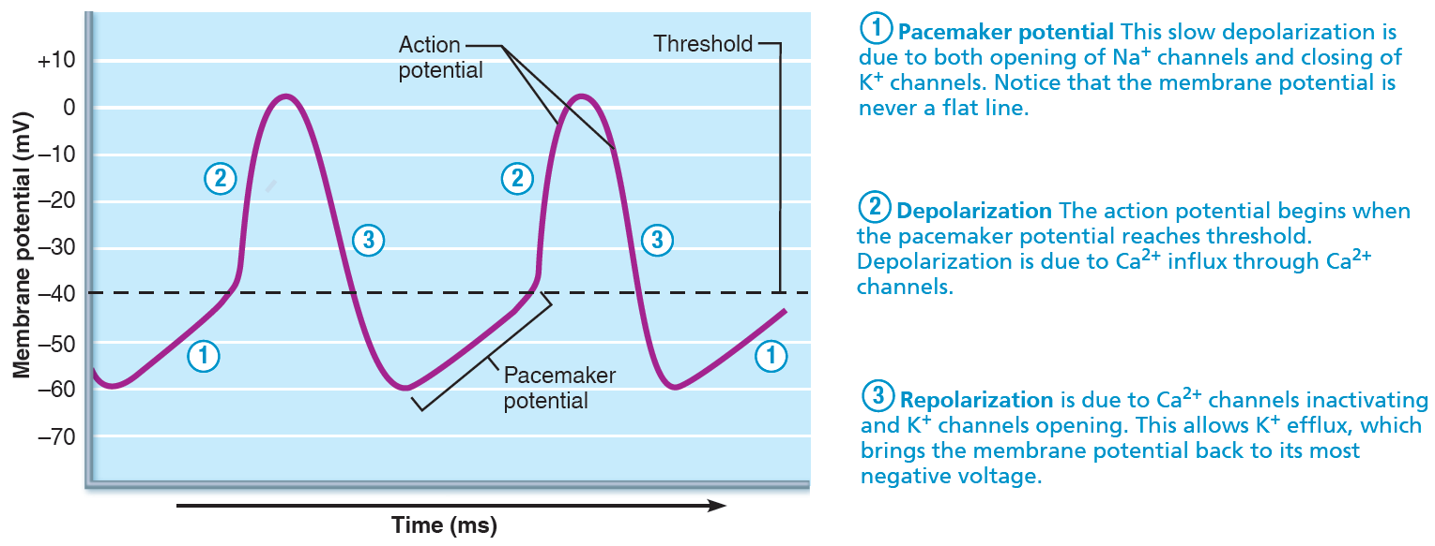
Pacemaker and Action Potentials of the Heart

Slide 37
Setting the Basic Rhythm: The Intrinsic Conduction System
Coordinated heartbeat is a function of:
Presence of gap junctions
Intrinsic cardiac conduction system
Network of noncontractile (autorhythmic) cells
Initiate and distribute impulses to coordinate depolarization and contraction of heart

Slide 38
Setting the Basic Rhythm: The Intrinsic Conduction System (cont.)
Action potential initiation by pacemaker cells
Cardiac pacemaker cells have unstable resting membrane potentials called pacemaker potentials or prepotentials
Three parts of action potential
Pacemaker potential: K⁺ channels are closed, but slow Na⁺ channels are open, causing interior to become more positive

Slide 39
Setting the Basic Rhythm: The Intrinsic Conduction System (cont. 2)
Action potential initiation by pacemaker cells (cont.)
Depolarization: Ca²⁺ channels open (around −40 mV), allowing huge influx of Ca²⁺, leading to rising phase of action potential
Repolarization: K⁺ channels open, allowing efflux of K⁺, and cell becomes more negative

Slide 40
Rhythm of Conduction System
SA node (PACEMAKER) fires spontaneously 90-100 times per minute
AV node fires at 40-50 times per minute
If both nodes are suppressed, AV bundle fibers in ventricles by themselves fire only 20-40 times per minute

Slide 41
Heart Physiology: Sequence of Excitation
AV nodal delay – slowing of conduction through fibrous skeleton to ensure ventricles contract after atria complete their contraction
AV bundle splits into two pathways in the interventricular septum (bundle branches)
Bundle branches carry the impulse toward the apex of the heart
Purkinje fibers carry the impulse to the heart apex and ventricular walls

Slide 42
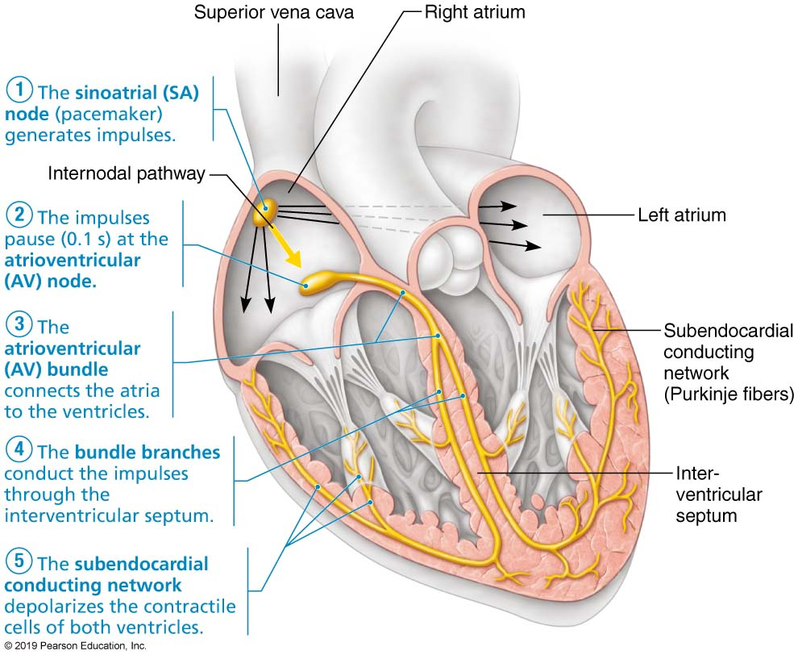
Cardiac Intrinsic Conduction

Slide 43
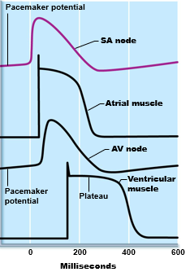
Figure: Intrinsic cardiac conduction system and action potential succession during one heartbeat.
Comparison of action potential shape
at various locations

Slide 44
Clinical – Homeostatic Imbalance 18.4
Defects in intrinsic conduction system may cause:
Arrhythmias: irregular heart rhythms
Uncoordinated atrial and ventricular contractions
Fibrillation: rapid, irregular contractions
Heart becomes useless for pumping blood, causing circulation to cease; may result in brain death
Treatment: defibrillation interrupts chaotic twitching, giving heart “clean slate” to start regular, normal depolarizations

Slide 45
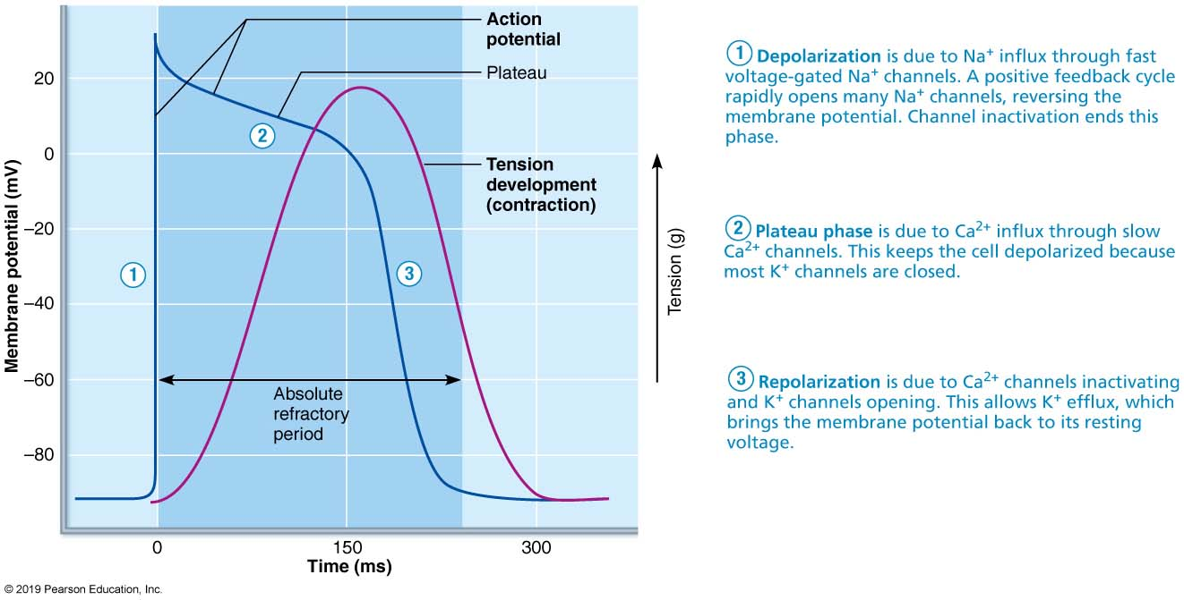
Contractile Cardiac Cell Membrane Potential

Slide 46
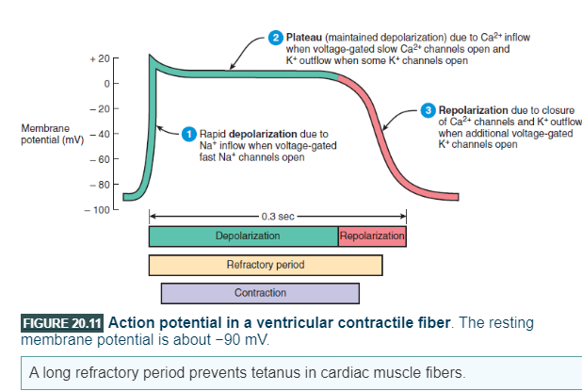
Contractile cell action potential

Slide 47
Contractile cells: Action potentials
Depolarization
Cardiac cell resting membrane potential is -90mv
excitation spreads through gap junctions
fast Na+ channels open for rapid depolarization
Plateau phase
250 msec (only 1msec in neuron)
slow Ca⁺² channels open, let Ca ⁺², while K⁺ channels close
Ca ⁺² binds to troponin to allow for actin-myosin cross-bridge formation & tension development
Repolarization
Ca⁺² channels close and K⁺ channels open & -90mv is restored as potassium leaves the cell
Refractory period
very long so heart can fill

Slide 48
Action Potentials of Contractile Cardiac Muscle Cells
Contractile muscle fibers make up bulk of heart and are responsible for pumping action
Different from skeletal muscle contraction; cardiac muscle action potentials have plateau
Steps involved in AP:
Depolarization opens fast voltage-gated Na⁺ channels; Na⁺ enters cell
Positive feedback influx of Na⁺ causes rising phase of AP (from −90 mV to +30 mV)

Slide 49
Action Potentials of Contractile Cardiac Muscle Cells pt 2
Depolarization by Na⁺ also opens slow Ca²⁺ channels
At +30 mV, Na⁺ channels close, but slow Ca²⁺ channels remain open, prolonging depolarization
Seen as a plateau
After about 200 ms, slow Ca²⁺ channels are closed, and voltage-gated K⁺ channels are open
Rapid efflux of K⁺ repolarizes cell to RMP
Ca²⁺ is pumped both back into SR and out of cell into extracellular space

Slide 50
Action Potentials of Contractile Cardiac Muscle Cells pt 3
Difference between contractile muscle fiber and skeletal muscle fiber contractions
AP in skeletal muscle lasts 1–2 ms; in cardiac muscle it lasts 200 ms
Contraction in skeletal muscle lasts 15–100 ms; in cardiac contraction lasts over 200 ms
Benefit of longer AP and contraction:
Sustained contraction ensures efficient ejection of blood
Longer refractory period prevents tetanic contractions

Slide 51
Electrocardiography
Electrical activity is recorded by electrocardiogram (ECG)
P wave corresponds to depolarization of SA node
QRS complex corresponds to ventricular depolarization
T wave corresponds to ventricular repolarization
Atrial repolarization record is masked by the larger QRS complex
PLAY
InterActive Physiology ®:
Intrinsic Conduction System, pages 3–6

Slide 52
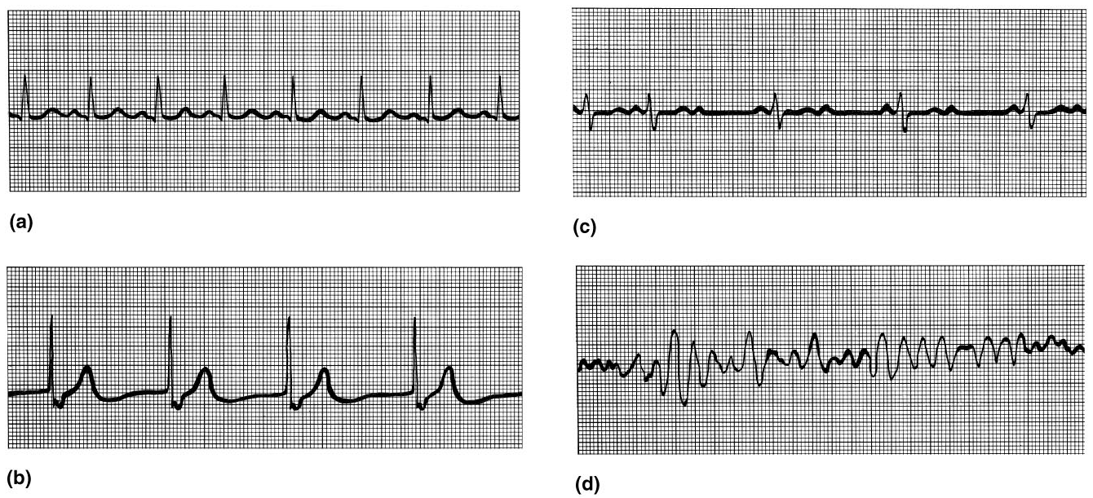
ECG Tracings
Figure 18.18

Slide 53
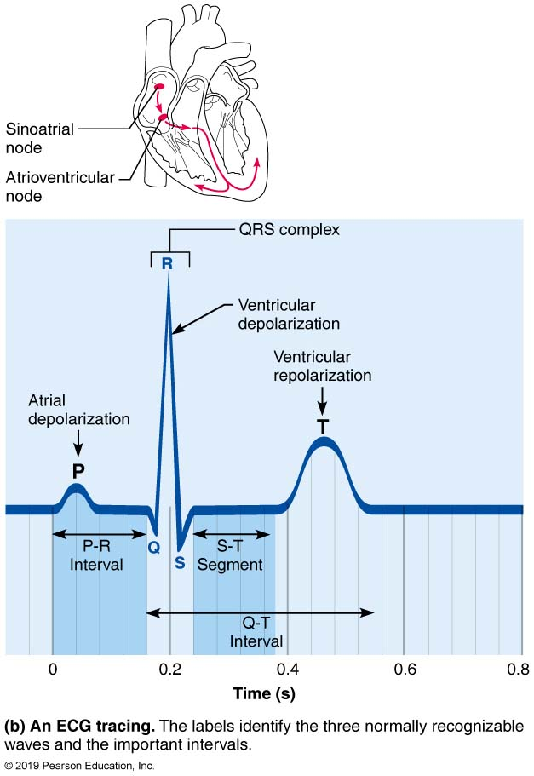
BIG TOPIC: Electrocardiography

Slide 54
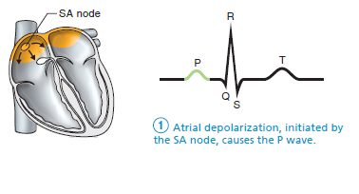
Heart Excitation Related to ECG
SA node generates impulse;
atrial excitation begins

Slide 55
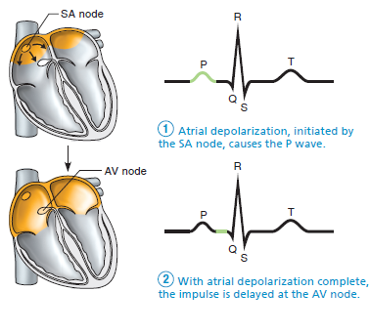
Heart Excitation Related to ECG pt 2
Impulse delayed at AV node

Slide 56
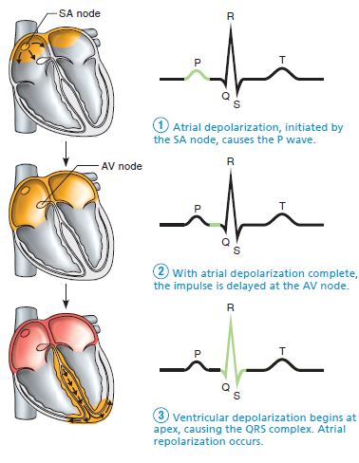
Heart Excitation Related to ECG pt 3
Impulse passes to heart apex; ventricular excitation begins

Slide 57
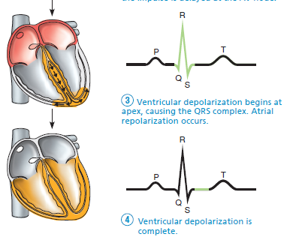
Heart Excitation Related to ECG pt 4
Ventricular excitation complete

Slide 58
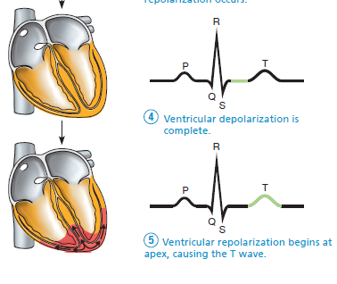
Heart Excitation Related to ECG pt 5

Slide 59
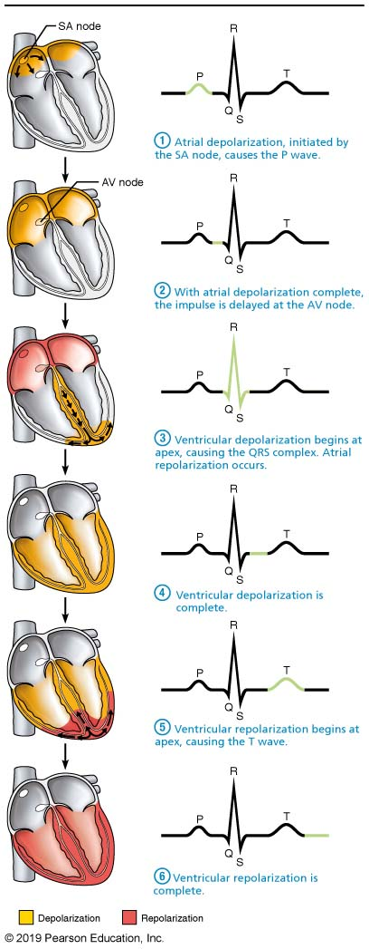
Heart Excitation Related to ECG

Slide 60
Clinical – Homeostatic Imbalance 18.5
Changes in patterns or timing of ECG may reveal diseased or damaged heart, or problems with heart’s conduction system
Problems that can be detected:
Enlarged R waves may indicate enlarged ventricles
Elevated or depressed S-T segment indicates cardiac ischemia

Slide 61
BIG TOPIC: Regulation of Heart Activity
Heart rate can be regulated by:
Nervous control (Autonomic nervous system)
Endocrine control (hormones like epinephrine)
Intrinsic control (autorhythmic cells)
Other factors

Slide 62
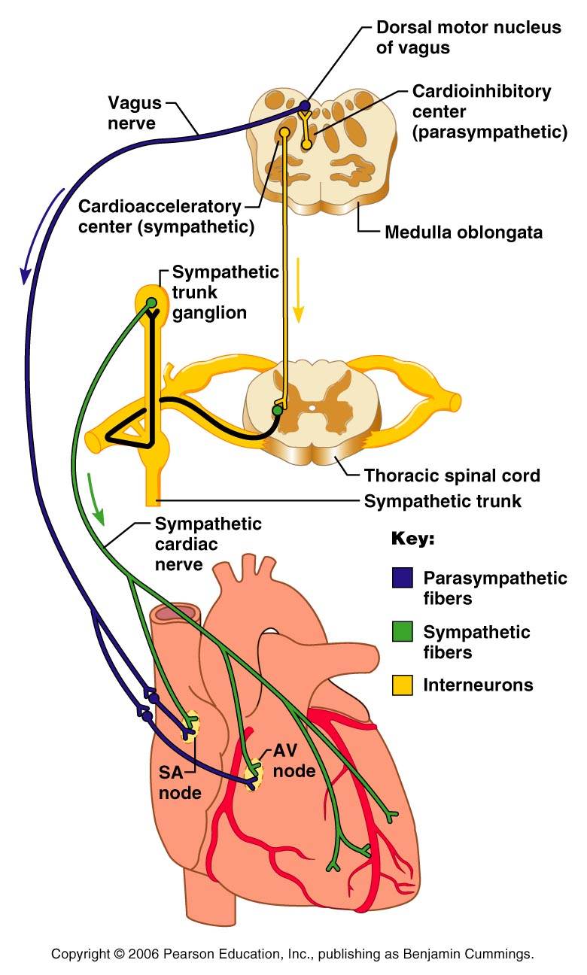
Extrinsic Innervation of the Heart
Heart is stimulated by the sympathetic cardioacceleratory center
Heart is inhibited by the parasympathetic cardioinhibitory center
Figure 18.15

Slide 63
Chemical Regulation of the Heart
The hormones epinephrine and thyroxine increase heart rate
Intra- and extracellular ion concentrations must be maintained for normal heart function
PLAY
InterActive Physiology ®: Cardiac Output, pages 3–9

Slide 64
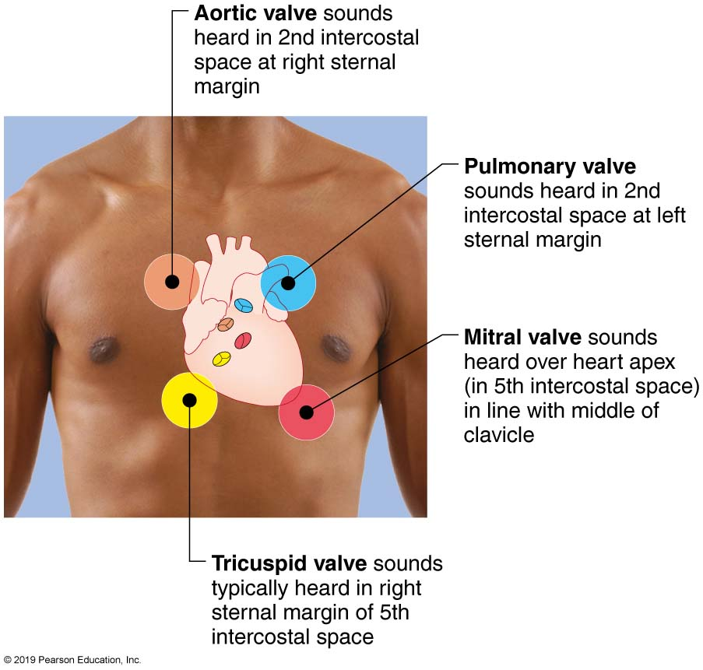
Other ways of assessing heart health: Auscultation - Heart Sounds

Slide 65
Heart Sounds (Auscultation)
Heart sounds (lub-dup) are associated with closing of heart valves
First sound occurs as AV valves close and signifies beginning of systole
Second sound occurs when SL valves close at the beginning of ventricular diastole

Slide 66
Cardiac Cycle
Cardiac cycle refers to all events associated with blood flow through the heart
Systole – contraction of heart muscle
Diastole – relaxation of heart muscle

Slide 67
18.6 Mechanical Events of Heart
Ventricular filling: mid-to-late diastole
Pressure is low; 80% of blood passively flows from atria through open AV valves into ventricles from atria (SL valves closed)
Atrial depolarization triggers atrial systole (P wave), atria contract, pushing remaining 20% of blood into ventricle
End diastolic volume (EDV): volume of blood in each ventricle at end of ventricular diastole
Depolarization spreads to ventricles (QRS wave)
Atria finish contracting and return to diastole while ventricles begin systole

Slide 68
18.6 Mechanical Events of Heart pt 2
Ventricular systole
Atria relax; ventricles begin to contract
Rising ventricular pressure causes closing of AV valves
Two phases
2a: Isovolumetric contraction phase: all valves are closed
2b: Ejection phase: ventricular pressure exceeds pressure in large arteries, forcing SL valves open
Pressure in aorta around 120 mm Hg
End systolic volume (ESV): volume of blood remaining in each ventricle after systole

Slide 69
18.6 Mechanical Events of Heart pt 3
Isovolumetric relaxation: early diastole
Following ventricular repolarization (T wave), ventricles are relaxed; atria are relaxed and filling
Backflow of blood in aorta and pulmonary trunk closes SL valves
Causes dicrotic notch (brief rise in aortic pressure as blood rebounds off closed valve)
Ventricles are totally closed chambers (isovolumetric)
When atrial pressure exceeds ventricular pressure, AV valves open; cycle begins again

Slide 70
BIG TOPIC: Assessing heart efficiency: Cardiac Output (CO) and Reserve
CO is the amount of blood pumped by each ventricle in one minute
CO is the product of heart rate (HR) and stroke volume (SV)
CO = HR x SV
HR is the number of heart beats per minute
SV is the amount of blood pumped out by a ventricle with each beat
Cardiac reserve is the difference between resting and maximal CO

Slide 71
Cardiac Output: Example
CO (ml/min) = HR (75 beats/min) x SV (70 ml/beat)
CO = 5250 ml/min (5.25 L/min)

Slide 72
Factors Affecting Stroke Volume
Preload – amount ventricles are stretched by contained blood
Contractility – cardiac cell contractile force due to factors other than EDV
Afterload – back pressure exerted by blood in the large arteries leaving the heart

Slide 73
Frank-Starling Law of the Heart
Preload, or degree of stretch, of cardiac muscle cells before they contract is the critical factor controlling stroke volume
Slow heartbeat and exercise increase venous return to the heart, increasing SV
Blood loss and extremely rapid heartbeat decrease SV

Slide 74
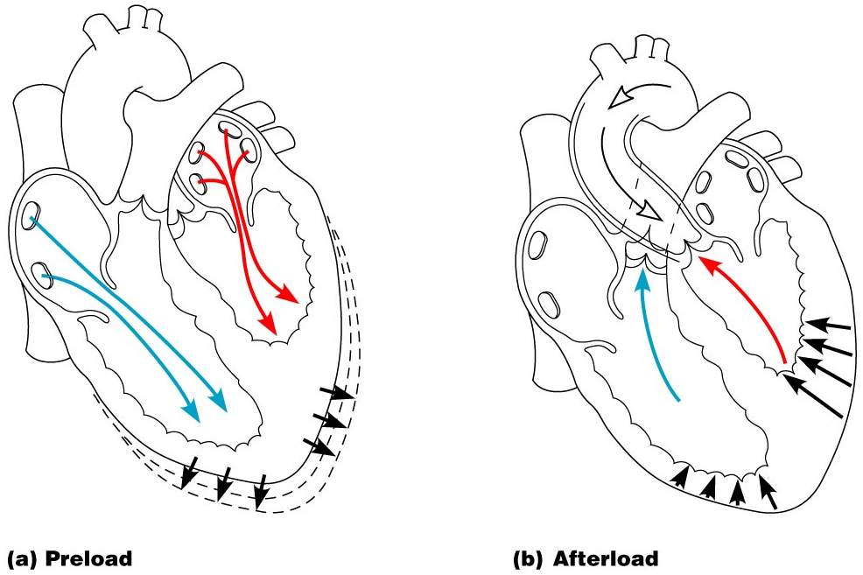
Preload and Afterload
Figure 18.21

Slide 75
Extrinsic Factors Influencing Stroke Volume
Contractility is the increase in contractile strength, independent of stretch and EDV
Increase in contractility comes from:
Increased sympathetic stimuli
Certain hormones
Ca²⁺ and some drugs

Slide 76
Extrinsic Factors Influencing Stroke Volume: other chemicals
Agents/factors that decrease contractility include:
Acidosis
Increased extracellular K⁺
Calcium channel blockers

Slide 77
Clinical – Homeostatic Imbalance 18.7
Hypocalcemia: depresses heart
Hypercalcemia: increases HR and contractility
Hyperkalemia: alters electrical activity, which can lead to heart block and cardiac arrest
Hypokalemia: results in feeble heartbeat; arrhythmias

Slide 78
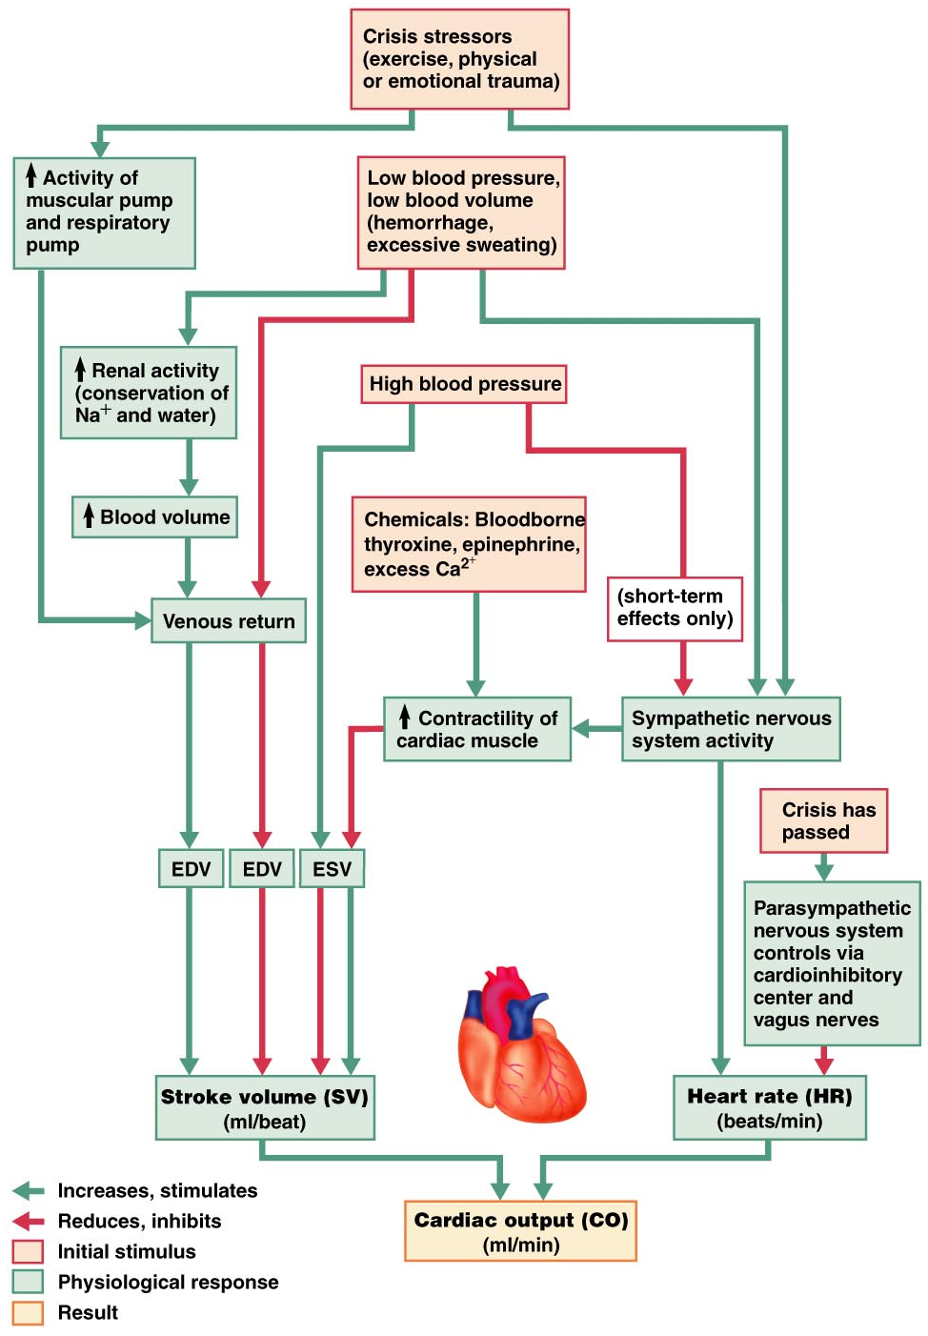
Factors affecting cardiac output

Slide 79
Developmental Aspects of the Heart
Fetal heart structures that bypass pulmonary circulation
Foramen ovale connects the two atria
Ductus arteriosus connects pulmonary trunk and the aorta

Slide 80
DISORDERS: HOMEOSTATIC IMBALANCES

Slide 81
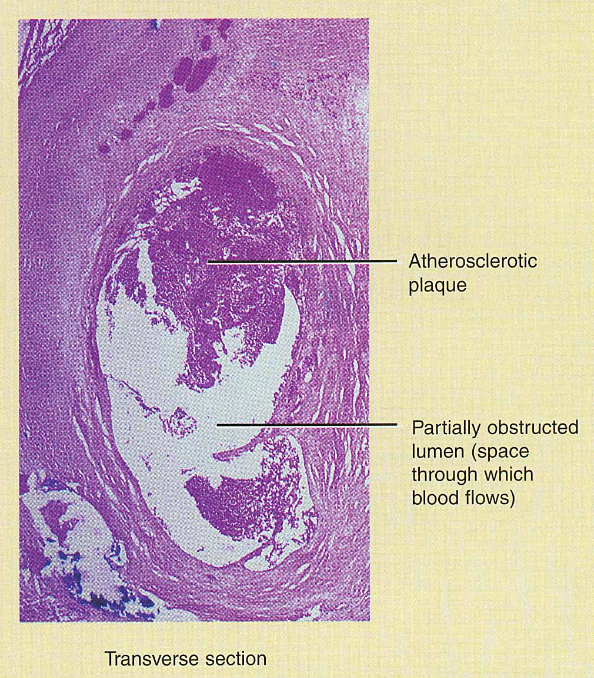
Coronary Artery Disease
Heart muscle receiving insufficient blood supply
narrowing of vessels---atherosclerosis, artery spasm or clot
atherosclerosis--smooth muscle & fatty deposits in walls of arteries
Treatment
drugs, bypass graft, angioplasty, stent

Slide 82
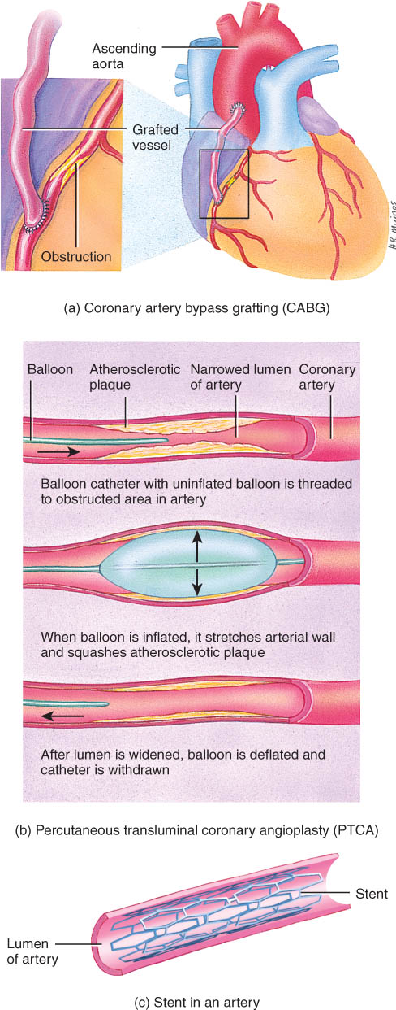
By-pass Graft

Slide 83
Percutaneous Transluminal Coronary Angioplasty Stent

Slide 84
Congenital Heart Defects
A congenital defect is a defect that exists at birth, and usually before birth.
Some congenital defects are not serious or remain asymptomatic; others heal themselves.
A few congenital defects are life threatening and must be corrected surgically. Fortunately, surgical techniques are highly refined for most of the defects listed.

Slide 85
Arrythmia
Arrhythmia (disrhythmia) is an irregularity in heart rhythm resulting from a defect in the conduction system of the heart.
Categories are:
bradycardia: slow heart beat (<60/min)
tachycardia: fast heart beat (>100/min)
fibrillation: uncontrolled contractions

Slide 86
Congestive Heart Failure
Congestive heart failure is a chronic or acute state that results when the heart is not capable of supplying the oxygen demands of the body.
Causes of CHF
coronary artery disease, hypertension, MI, valve disorders, congenital defects

